Slide 1
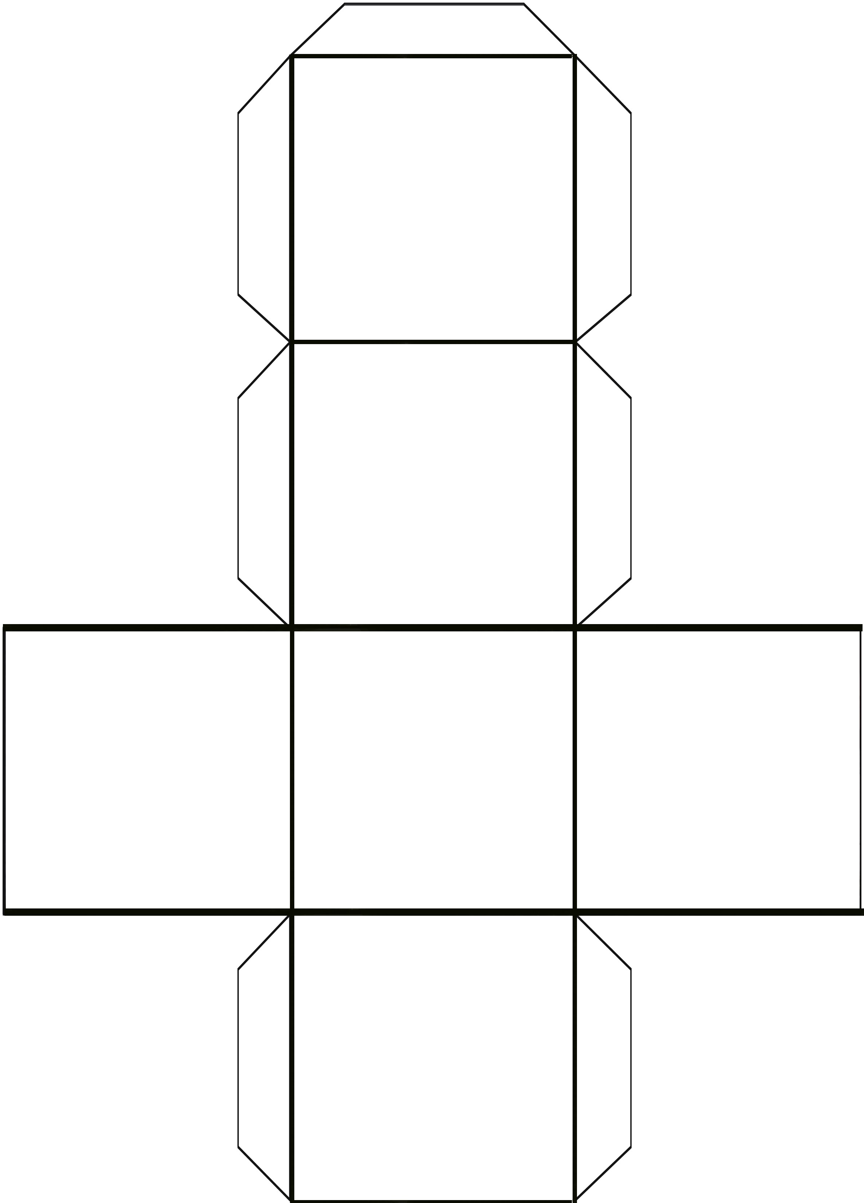
Creative Questions Cube
Cut out the diagram.
Fold and glue on the lines to form a cube.
Roll the cube.
Read the answer on the face of the cube.
Brainstorm questions for the answer.
Example: Answer: Only when I have to.
Question: When do I make my bed?
Make your own
creative cubes.
Only when I have to.
Anything that is hot.
Every time the dog barks.
After I finish my chores.
Because it is so loud.
When the first person arrives.

